Slide 1
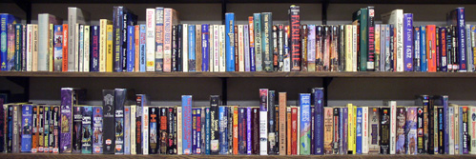
The Dewey Decimal System

Slide 2
The Dewey Decimal System
The Dewey Decimal Classification is a system of library classification made
up of ten main classes or categories, each divided into ten secondary classes
or subcategories, each having ten subdivisions. This system is a logical way of
classifying a large number of different topics or subjects.

Slide 3
The Dewey Decimal System
The Dewey Decimal Classification is a system of library classification made
up of ten main classes or categories, each divided into ten secondary classes
or subcategories, each having ten subdivisions. This system is a logical way of
classifying a large number of different topics or subjects.
This system was developed by Melvil Dewey in 1876 and has been updated
22 different times since then. The most recent update was in 2003.

Slide 4
The Dewey Decimal System
The Dewey Decimal Classification is a system of library classification made
up of ten main classes or categories, each divided into ten secondary classes
or subcategories, each having ten subdivisions. This system is a logical way of
classifying a large number of different topics or subjects.
This system was developed by Melvil Dewey in 1876 and has been updated
22 different times since then. The most recent update was in 2003.
We only use Dewey call numbers on non-fiction books, for fiction books and
easy books we use the author’s last name.

Slide 5
The Dewey Decimal System
Here are the ten main topics used for the Dewey System:
000 – Computer science, information & general works
100 – Philosophy and psychology
200 – Religion
300 – Social sciences
400 – Language
500 – Science (including mathematics)
600 – Technology
700 – Arts and recreation
800 – Literature
900 – History, geography, and biography

Slide 6
The Dewey Decimal System
The 000’s (001 – 099)
000 – Generalities
010 – Bibliography
020 – Library sciences
030 – Encyclopedia and mixed topics
050 – Serials and Indexes
060 – Museums
070 – Journalism, News Media
080 – General collections
090 – Manuscripts and Rare books

Slide 7
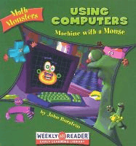
The Dewey Decimal System
Books listed under 000’s:

Slide 8
The Dewey Decimal System
More books listed under 000’s:

Slide 9
The Dewey Decimal System
The 100’s (100 – 199):
100 – Philosophy and Psychology
110 – Metaphysics
120 – Epistemology
130 – Paranormal Phenomena (ghosts)
140 – Philosophical Schools
150 – Psychology
160 – Logic
170 – Ethics (morals)
180 – Ancient, medieval, and Oriental philosophy
190 – Modern Western philosophy

Slide 10
The Dewey Decimal System
Some books listed under the 100’s:

Slide 11
The Dewey Decimal System
More books listed under the 100’s:

Slide 12
The Dewey Decimal System
(200 – 299)
200 – Religion
210 – Natural Theology
220 – Bible
230 – Christian Theology
240 – Christian moral & devotional theology
250 – Christian orders & local church
260 – Christian social theology
270 – Christian church history
280 – Christian denominations and sects
290 – Other (World) Religions

Slide 13
The Dewey Decimal System

Slide 14
The Dewey Decimal System
The 300’s – (300 – 399)
300 – Social Sciences
310 – General Statistics
320 – Political Science (government)
330 – Economics (business and money)
340 – Law and law enforcement
350 – Public Administration
360 – Social Services
370 – Education
380 – Commerce, communications, transportation
390 – Customs, fairy tales, folklore

Slide 15
The Dewey Decimal System

Slide 16
The Dewey Decimal System

Slide 17
The Dewey Decimal System

Slide 18
The Dewey Decimal System
The 400’s – (400 – 499)
400 Language
410 – Linguistics
420 - English 423 - Dictionaries 430 - German 440 - French 450 - Italian 460 - Spanish 470 - Latin 480 - Greek 490 - Other languages

Slide 19
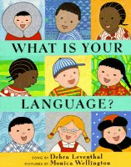
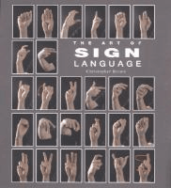
The Dewey Decimal System
The 400’s - Language….

Slide 20
The Dewey Decimal System
The 400’s - Language….

Slide 21
The Dewey Decimal System
The 500’s - (500 – 599)
500 – Natural Sciences and Math
510 – Mathematics
520 – Astronomy
530 – Physics
540 – Chemistry
550 – Earth Sciences
560 – Paleontology (dinosaurs)
570 – Life Sciences (biology)
580 – Botanical Sciences (plants)
590 – Zoological Sciences (animals)

Slide 22
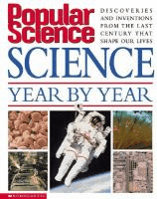
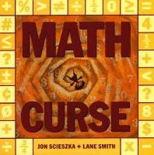
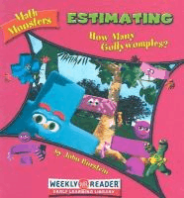
The Dewey Decimal System
The 500’s - Natural Sciences and Math….

Slide 23
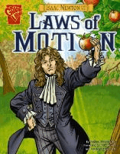
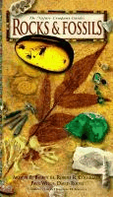
The Dewey Decimal System
The 500’s - Natural Sciences and Math….

Slide 24
The Dewey Decimal System
The 600’s – (600 – 699)
600 – Applied Sciences (Technology)
610 – Medical sciences (medicine)
620 – Engineering
630 – Agriculture (pets)
640 – Home economics and family living (cooking)
650 – Management and auxiliary services
660 – Chemical engineering
670 – Manufacturing
680 – Manufacture for specific uses
690 – Buildings

Slide 25
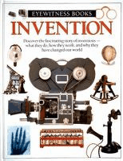
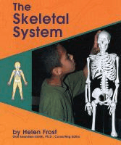
The Dewey Decimal System
The 600’s - Applied Sciences (technology)….

Slide 26
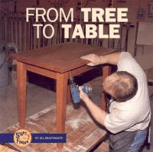
The Dewey Decimal System
The 600’s - Applied Sciences (technology)….

Slide 27
The Dewey Decimal System
The 700’s – (700 – 799)
700 – Arts and Recreation
710 – Civic & landscape art
720 – Architecture
730 – Sculpture
740 – Drawing and crafts
750 – Painting and paintings
760 – Graphic Arts, Printmaking
770 – Photography and photographs
780 – Music
790 – Performing Arts (dance), Recreation (games)
and Sports

Slide 28
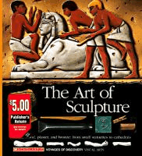
The Dewey Decimal System
The 700’s - Arts and Recreation….

Slide 29
The Dewey Decimal System
The 700’s - Arts and Recreation….

Slide 30
The Dewey Decimal System
The 800’s – (800 – 899)
800 – Literature
810 – American literature in English
820 – English & Old English Literature
830 – German Literature
840 – French Literature
850 – Italian Literature
860 – Spanish Literature
870 – Latin Literature
880 – Greek Literature
890 – Literature of other languages

Slide 31
The Dewey Decimal System
The 800’s - Literature….

Slide 32
The Dewey Decimal System
The 800’s - Literature….

Slide 33
The Dewey Decimal System
The 900’s – (900 – 999)
900 – Geography and History
910 – Geography and Travel
920 – Biography
930 – Ancient World History
940 – European History
950 – Asian History
960 – African History
970 – North American History (US History)
980 – South American History
990 – General History of other areas

Slide 34
The Dewey Decimal System
The 900’s – Geography and History….

Slide 35
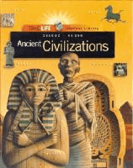
The Dewey Decimal System
The 900’s – Geography and History….

