Slide 1
Dictionary Skills

Slide 2
Dictionary Skills
Experts believe that most English-speaking adults use between 25,000 and 50,000 words.
That seems like a large number, yet the English language has over a million words.

Slide 3
Dictionary Skills
Experts believe that most English-speaking adults use between 25,000 and 50,000 words.
That seems like a large number, yet the English language has over a million words.
Effective readers use a dictionary to understand new or difficult words.

Slide 4
Dictionary Skills
Most dictionaries provide the following information:
• Guide words (the words at the top of each page)
• Spelling (how the word and its different forms are spelled)
• Pronunciation (how to say the word)
• Part of speech (the function of the word)
• Definition (the meaning of the word)
• Synonyms (words that have similar meanings)
• Syllables (parts of a word that are said as a single sound)

Slide 5
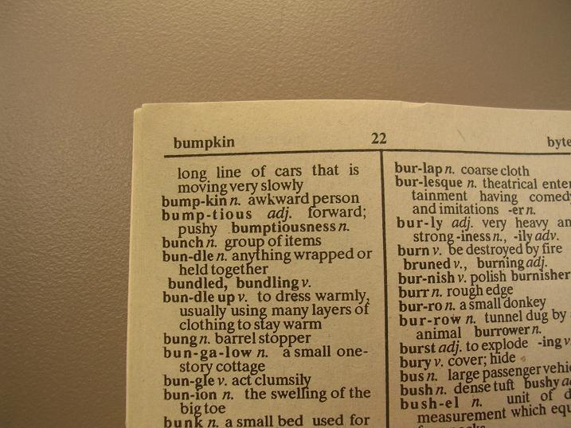
Dictionary Skills
Guide words (the words at the top of each page)

Slide 6
Dictionary Skills
Guide words (the words at the top of each page)
These words help us
figure out what words
will be on the page we
are looking at.

Slide 7
Dictionary Skills
Spelling (how the word and its different forms are spelled)
big adjective 1. Of great size; large. 2. Of great importance:
Graduation was a big event in my life. big (big) adjective
bigger, biggest

Slide 8
Dictionary Skills
Pronunciation (how to say the word)
bə twin = between
fyu chər = future
me ni = many
si zən = season
Pronunciation Key
\ \ abut \ \ kitten, F table \ r\ further \a\ ash \ ¯a\ ace \ä\ mop, mar
\a˙u\ out \ch\ chin \e\ bet \¯e\easy \g\ go \i\ hit \¯i\ ice \ j\ job
\ \ sing \¯o\ go \ ˙o\ law \ ˙oi\ boy \ th\ thin \ th\ the \ü\ loot \˙u\ foot
\ y\ yet \zh\ vision \a˙, k, n, oe, oe¯¯ , ue, u¯¯e, y\

Slide 9
Dictionary Skills
Part of speech (the function of the word)
Noun, verb, adjective, adverb, conjunction, or preposition
big adjective 1. Of great size; large. 2. Of great importance:
Graduation was a big event in my life. big (big) adjective
bigger, biggest

Slide 10
Dictionary Skills
Definition (the meaning of the word)
big adjective 1. Of great size; large. 2. Of great importance:
Graduation was a big event in my life. big (big) adjective
bigger, biggest

Slide 11
Dictionary Skills
Synonyms (words that have similar meanings)
big adjective 1. Of great size; large. 2. Of great importance:
Graduation was a big event in my life. big (big) adjective
bigger, biggest syn; large, great, important

Slide 12
Dictionary Skills
Syllables (parts of a word that are said as a single sound)
syllable = syl-la-ble mammal = mam-mal
interesting = in-ter-est-ing follow = fol-low
between = be-tween best = best
argument = ar-gu-ment location = lo-ca-tion

