Slide 1
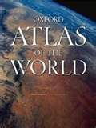
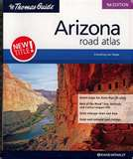
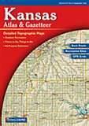
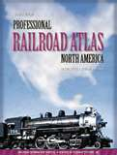
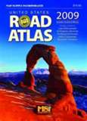
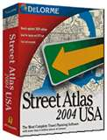
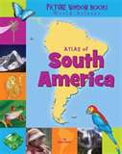
Atlas

Slide 2
Atlas
An atlas is a book of maps – a reference tool
which can help you find information about
different places

Slide 3
Atlas
An atlas is a book of maps – a reference tool
which can help you find information about
different places
An atlas contains information about cities,
states, and countries. It gives you information
about geography, area, capitals, population,
distance, and other information.

Slide 4
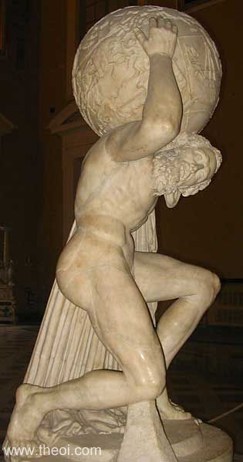
Atlas
The Atlas is named after a mythological character.
Atlas was one of the Titans, the first gods of Greek mythology. After losing a disagreement with Zeus, Atlas was forced to support the earth on his
shoulders, forever!

Slide 5
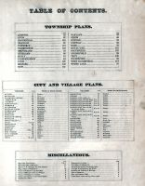
Atlas
Parts of an Atlas
Table of Contents – found at the front of the atlas, divides the book into major sections (chapters), and tells which pages these are on.

Slide 6
Atlas
Parts of an Atlas
Index – located in the back of the book this listing helps locate
specific information. Arranged alphabetically it will give a page
number and a grid reference for all of the locations listed.
A
Abbeville, LA …..70 D2
Abbeville, SC ….. 114 B2
Aberdeen, MD…..74 A5
Aberdeen, SD ….. 116 B4
Abilene, KS …… 66 B6

Slide 7
Atlas
Parts of an Atlas
Legend – small key found on each map that explains what each of the symbols means.
Legend
==== Interanational
Boundary
______ State Boundary
State Capital
Other City

Slide 8
Atlas
Parts of an Atlas
Scale of Miles – located on each map these help convert inches on the map to actual miles.

Slide 9
Atlas
Parts of an Atlas
Compass Rose – a figure used on the map to show orientation of directions (North, South, East, West).

Slide 10
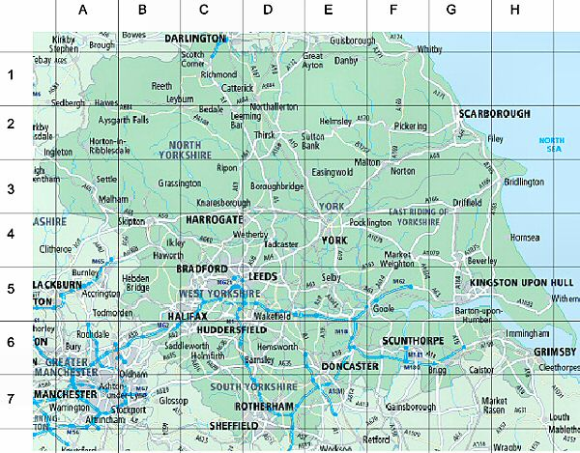
Atlas
Parts of an Atlas
Grid – a way to reference a certain place or position on a map.
It divides the map into small units and makes it easier to find things.

Slide 11
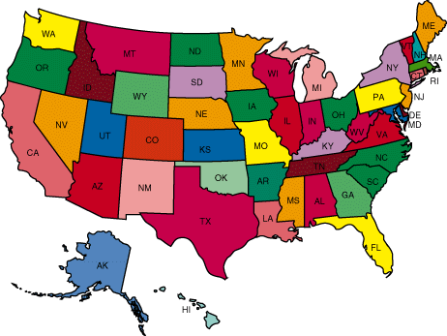
Atlas
Types of Maps
Political Maps – mainly show political features like boundaries, cities, states, and capitals.

Slide 12
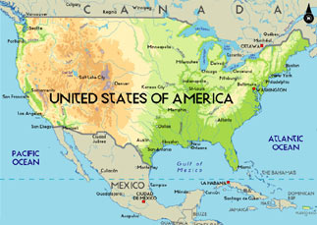
Atlas
Types of Maps
Physical Maps – focus more on showing geographical details like: mountains, rivers, lakes, oceans, deserts, forests, and other naturally occurring landmarks.

Slide 13
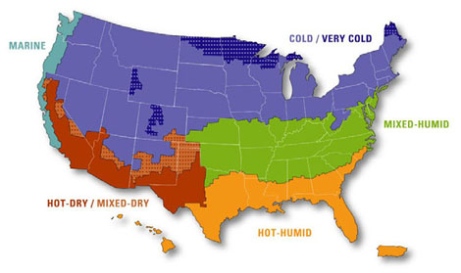
Atlas
Other types of maps
Climate and weather – shows typical temperature and seasonal conditions.

Slide 14
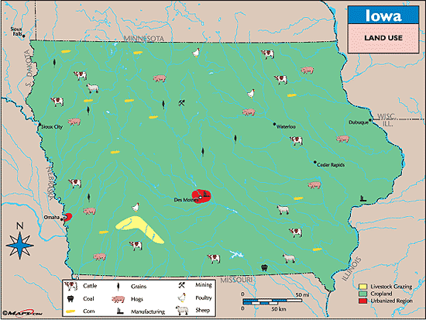
Atlas
Other types of maps
Land use maps – show what types of things the land is being used for and what types of resources are found there.

Slide 15
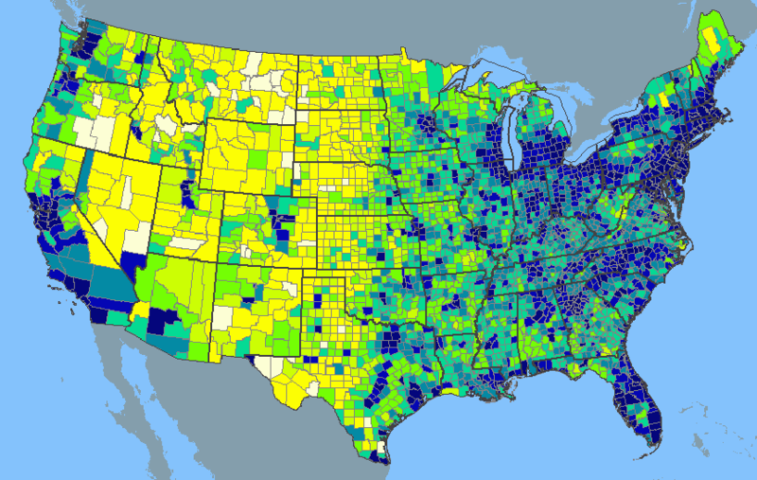
Atlas
Other types of maps
Population Density maps – show where people are concentrated by giving persons per square mile information.

Slide 16
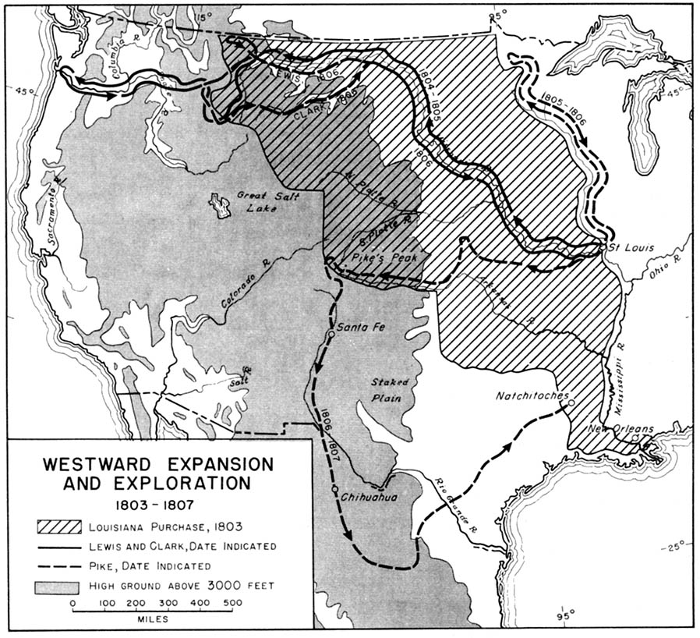
Atlas
Other types of maps
Historical Maps – show a certain area the way that it was during the past. May also track locations and movements of historical events.

Slide 17
Atlas

Slide 18
Atlas

