Slide 1
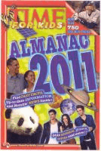
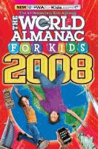
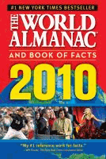
Almanac
A book that is printed annually that contains all types of facts, data, and statistics about many, many subjects

Slide 2
Almanac
Almanacs contain information about a wide range of topics, including:
News and current events
Animals, Energy, and other Science
Buildings, Transportation, Computers
Geography, Travel, and Countries
Government and history
Sports, Games, Hobbies
TV, Movies, and Music

Slide 3
Almanac
Early Almanacs tried to predict the future by using astrology and other fortune telling tricks to tell what the weather will be or how good the growing season will be, or how well the fish will bite on a certain day and other things that can be predicted well.

Slide 4
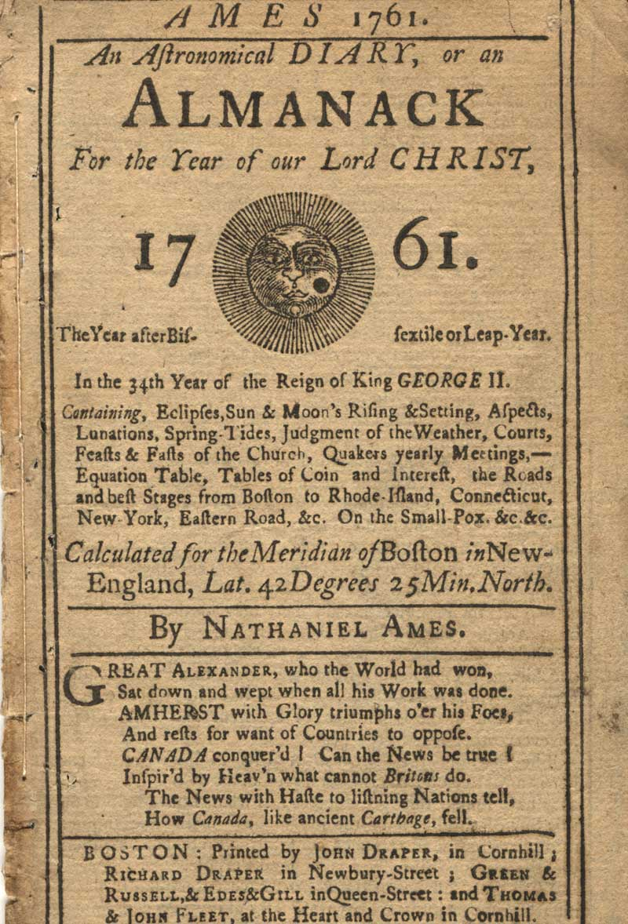
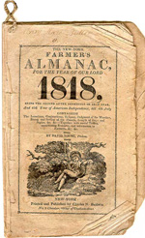
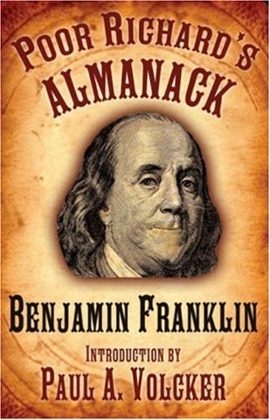
Almanac
Some of the early famous almanacs were:
The Farmers Almanac
Poor Richards Almanac (done by Ben Franklin)
Astronomical Almanac

Slide 5
Almanac
Some of the Almanacs we have include:

Slide 6
Almanac
Some of the Almanacs we have include:

Slide 7
Almanac
Some of the Almanacs we have include:

Slide 8
Almanac
Some of the Almanacs we have include:

